Slide 1


RESTAURANT SURVEY APP PRESENTATION

Slide 2
THE NEED: UNDERSTANDING OUR DINERS
Abstract
Methodology
Introduction
Result
Problem
Conclusion
Objectives
Reference

Slide 3
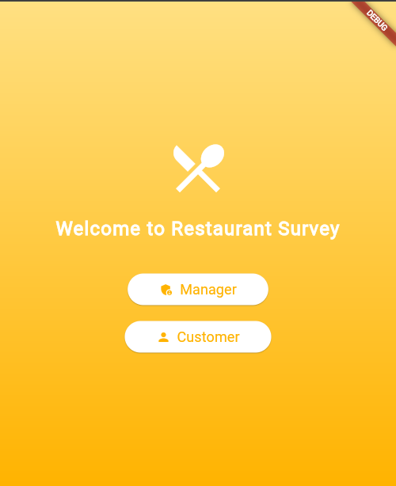
THE NEED: UNDERSTANDING OUR DINERS
How can we easily collect detailed meal feedback?
How can managers quickly see what customers think?

Slide 4
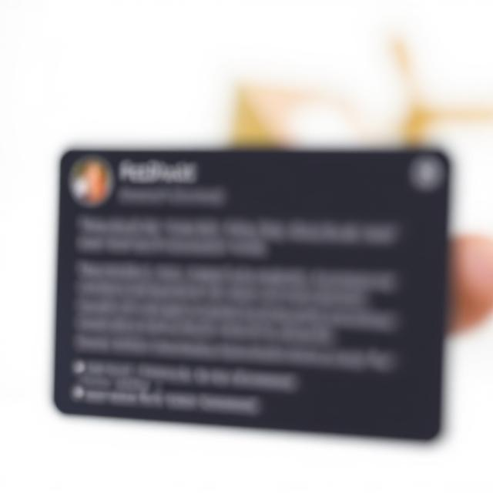
THE CHALLENGE: MISSING THE MARK ON CUSTOMER EXPERIENCE
Traditional feedback is often too general or too late.
Difficulty in pinpointing specific meal issues.
Missed opportunities to improve and retain customers.

Slide 5
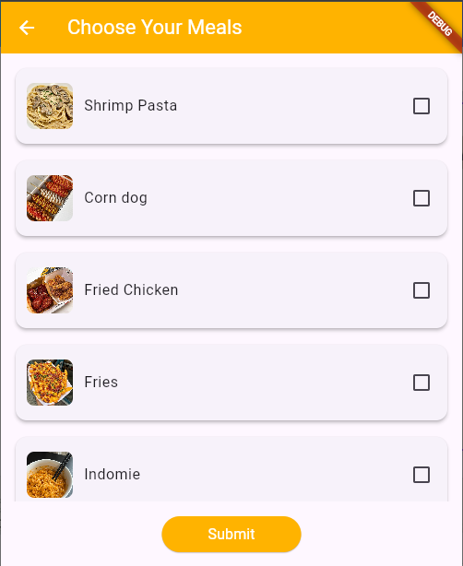
OUR SOLUTION: RESTAURANT SURVEY APP - DIRECT INSIGHTS, BETTER DINING
An intuitive app for rich, meal-specific customer feedback.
A powerful dashboard for actionable managerial insights.

Slide 6

BUSINESS BENEFITS: WHY THIS MATTERS
Improved Menu: Identify popular/unpopular dishes directly from customer ratings.
Enhanced Quality: Pinpoint issues with specific meals for targeted improvements.
Increased Customer Satisfaction: Show customers that their feedback is valued and acted upon.
Data-Driven Decisions: Make informed choices about menu changes, chef training, and operations.
Boosted Loyalty & Retention: Address concerns promptly, leading to happier, returning customers.

Slide 7
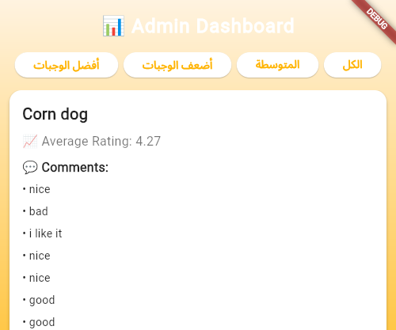
WHAT MAKES US DIFFERENT: KEY DIFFERENTIATORS (FEATURES)
Meal-Specific Feedback:
Customers rate individual dishes, not just the overall experience.
Instant Admin Dashboard:
Real-time access to aggregated ratings and comments.
User-Friendly Interface:
Simple for both customers and managers.

Slide 8
USER ROLES & KEY ACTIONS
Customers: Select Meals -> Rate & Comment -> Share Info (Optional)
Managers: Secure Login -> View Feedback -> Filter Insights

Slide 9
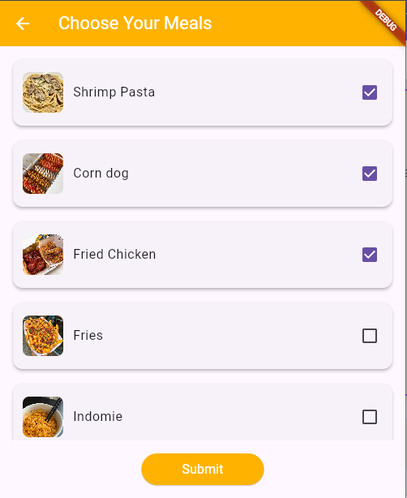
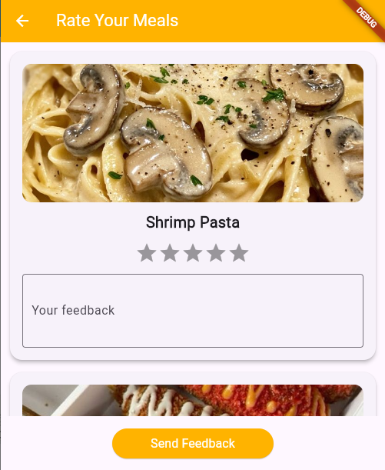
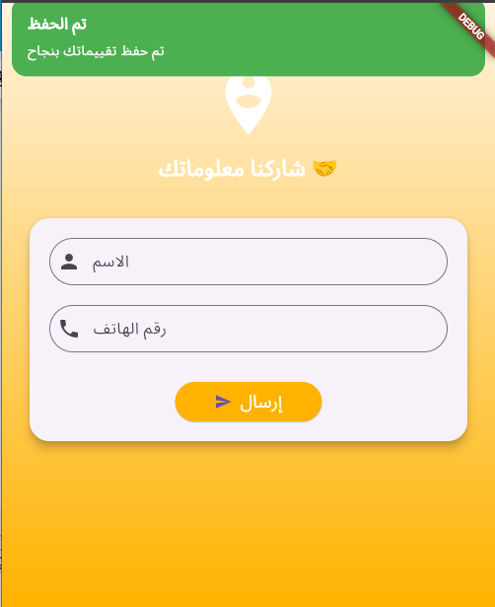
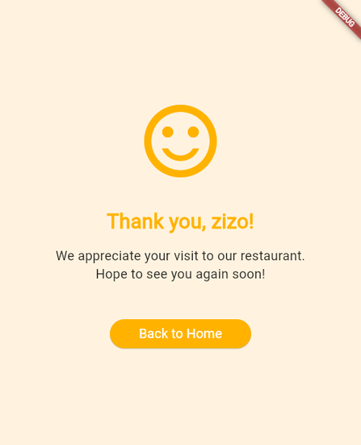
CUSTOMER JOURNEY: GIVING FEEDBACK
1. Choose Meals
2. Rate & Comment
3. Submit

Slide 10
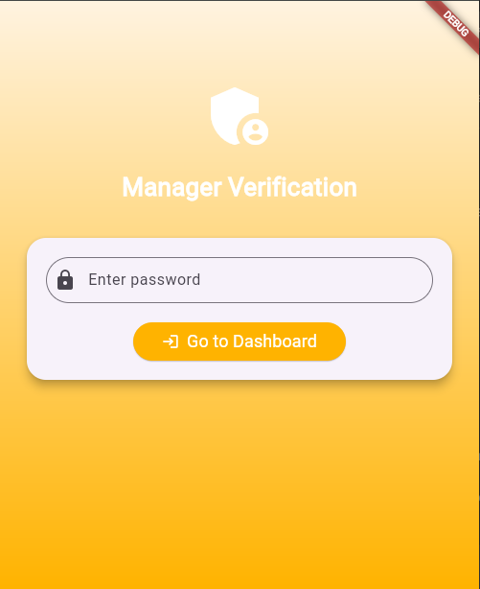
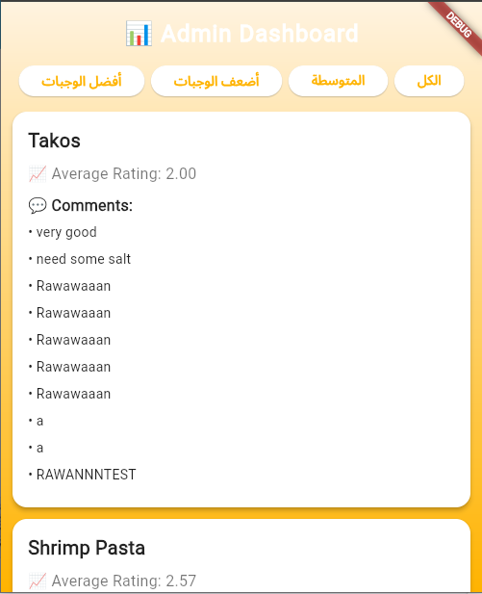
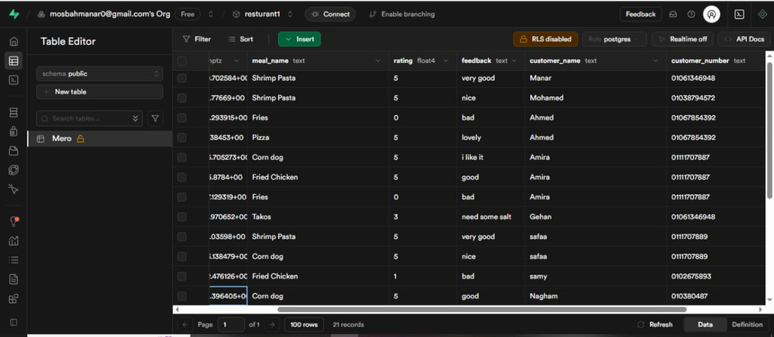
MANAGER JOURNEY: ACCESSING INSIGHTS
1. Verify Access
2. View Dashboard
3. Analyze Data

Slide 11
USER STORIES: MEETING USER NEEDS
Customer: "As a customer, I want to easily rate multiple meals so my specific feedback is captured."
Manager: "As a manager, I want to see average ratings for each meal so I can identify popular or problematic dishes."
Business Owner: "As a business owner, I want to understand customer preferences to optimize my menu and reduce waste."

Slide 12
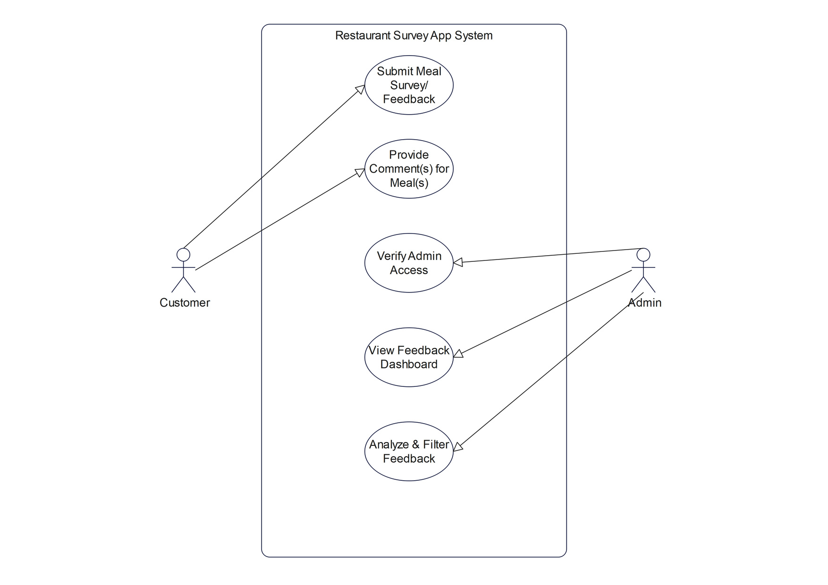
USE CASE DIAGRAM
App Use Cases
Actors: Customer, Manager, System (Supabase). Key Use Cases.

Slide 13
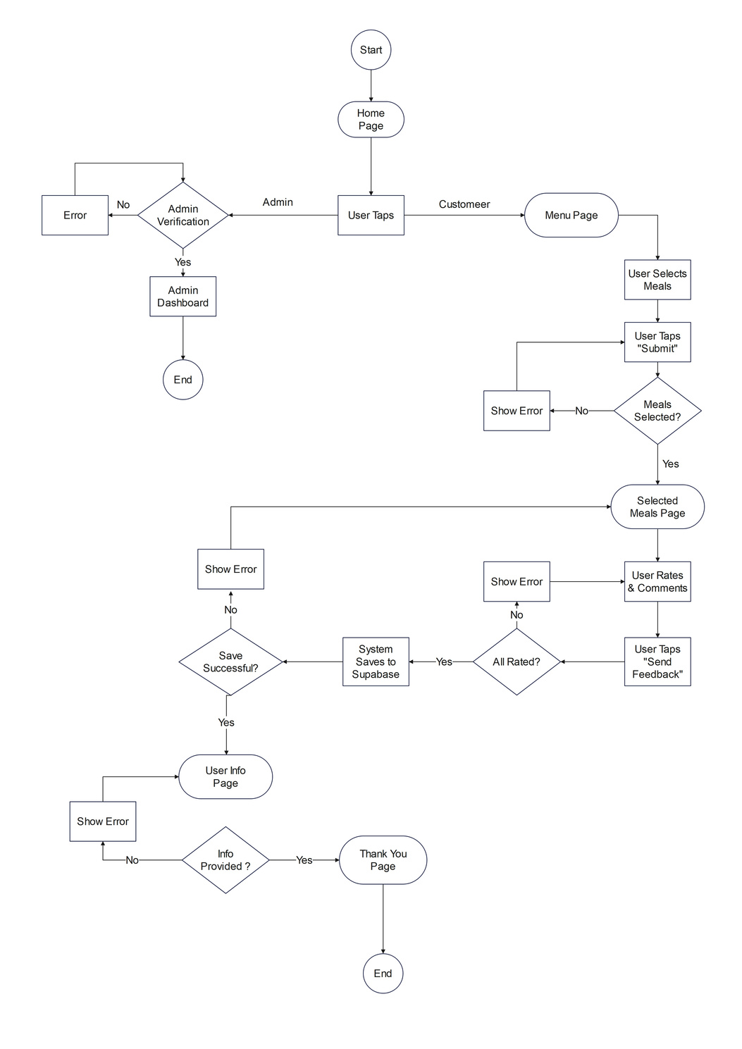
USER FLOW: CUSTOMER FEEDBACK PROCESS
Customer Feedback Flow & Admin Flow

Slide 14



TECHNOLOGY STACK (BRIEFLY)
Frontend: Flutter (Cross-platform)
State Management: GetX
Backend & DB: Supabase

Slide 15
Thank You
Questions?

